Slide 1
Murach’s PHP and MySQL (4th Edition)
Chapter 1
Introduction to web development with PHP

Slide 2
Objectives (part 1)
Applied
Use the XAMPP control panel to start or stop Apache or MySQL when it is running on your own computer.
Deploy a PHP application on your own computer.
Run a web application that’s on your own computer (1) by entering its URL into the address bar of a browser or (2) by getting and using an index of the applications on the web server.
View the source code for a web page in a web browser.

Slide 3
Objectives (part 2)
Knowledge
Describe the components of a client-server architecture.
Describe HTTP requests and responses.
Distinguish between the way a web server processes static web pages and dynamic web pages.
Explain what these software components do as a web application runs: Apache, PHP, Chrome, and MySQL.
Describe the difference between MySQL and MariaDB.
Describe the way a PHP application is deployed on your own computer or on an Internet server.
Describe the components of an HTTP URL.

Slide 4
Objectives (part 3)
Describe what happens if you omit one or more parts of a URL when you try to run an application or if you code a URL that specifies a directory that doesn’t contain a default page.
Describe the benefits of using an IDE like NetBeans for application development.

Slide 5
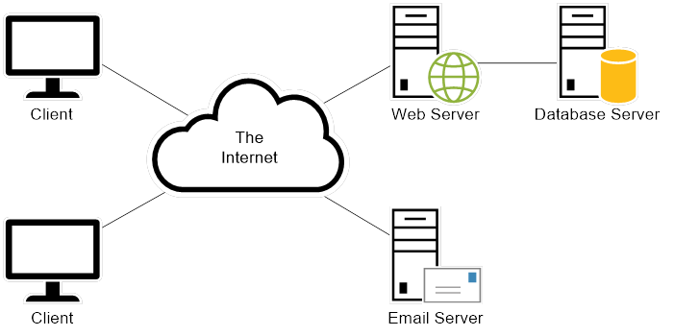
The architecture of a web application

Slide 6
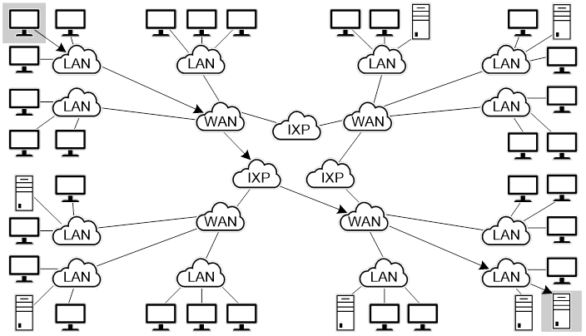
The architecture of the internet

Slide 7
Key terms for a client-server architecture
server
client
network
router
Local Area Network (LAN)
Wide Area Network (WAN)
internet
Internet Exchange Point (IXP)
Internet Service Provider (ISP)

Slide 8
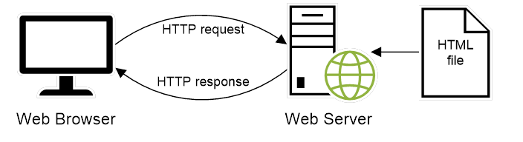
How a static web pages are processed with PHP

Slide 9
A simple HTTP request
GET / HTTP/1.1
Host: www.example.com
A simple HTTP response
HTTP/1.1 200 OK
Content-Type: text/html
Content-Length: 136
Server: Apache/2.4.51
<html>
<head>
<title>Example Web Page</title>
</head>
<body>
<p>This is a sample web page</p>
</body>
</html>

Slide 10
Two protocols that web applications depend upon
HyperText Transfer Protocol (HTTP)
Transmission Control Protocol/Internet Protocol (TCP/IP)

Slide 11
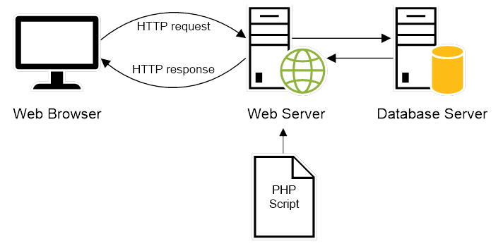
How dynamic web pages are processed with PHP

Slide 12
Key terms for web page processing
HyperText Markup Language (HTML)
static web page
HTTP request
HTTP response
dynamic web page
PHP interpreter
database server
render
round trip

Slide 13
Web browsers
Chrome
Safari
Edge
Firefox
Opera
Web servers
Apache
IIS

Slide 14
Database servers
MySQL
Oracle
PostgreSQL
MS SQL Server

Slide 15
Highlights in the history of PHP
Version | Year | Description
2 | 1995 | Personal Home Page.
3 | 1998 | PHP: Hypertext Processor.
4 | 2000 | Introduced the Zend Engine.
5 | 2004 | Introduced the Zend Engine II. Included support for the PHP Data Objects extension.
6 | N/A | Abandoned and never released.
7 | 2015 | Introduced the Zend Engine III, which resulted in significant performance improvements over Zend Engine II.
8 | 2020 | Introduced support for just-in-time (JIT) compilation, which can significantly improve performance for CPU-intensive applications.

Slide 16
Highlights in the history of MySQL
Version | Year | Description
3.23 | 1995 | The original version of MySQL.
4.0 | 2003 | Introduced support for unions.
4.1 | 2004 | Introduced support for subqueries and prepared statements.
5.0 | 2005 | Introduced support for stored procedures, triggers, views, and transactions.
5.1 | 2008 | Introduced support for row-based replication and server log tables.
5.5 | 2010 | Default storage engine now supports referential integrity.

Slide 17
Highlights in the history of MySQL (continued)
Version | Year | Description
5.6 | 2011 | Introduced support for big data.
5.7 | 2015 | Included security improvements and other enhancements.
8.0 | 2018 | Security and account management improvements, including support for roles.

Slide 18
MySQL notes
MySQL was originally owned and sponsored by MySQL AB, a for-profit firm.
In 2008, Sun Microsystems acquired MySQL AB.
In 2009, Oracle Corporation acquired Sun Microsystems.
In 2009, many of the original developers of MySQL left MySQL AB and began working on a fork of the open-source code. One of the most popular of these forks is MariaDB.
Many large companies, including Wikipedia and Google, have replaced MySQL with MariaDB.
MariaDB intends to maintain high compatibility with MySQL so it can work as a drop-in replacement for MySQL.
XAMPP 5.6 and later include MariaDB, not MySQL.

Slide 19
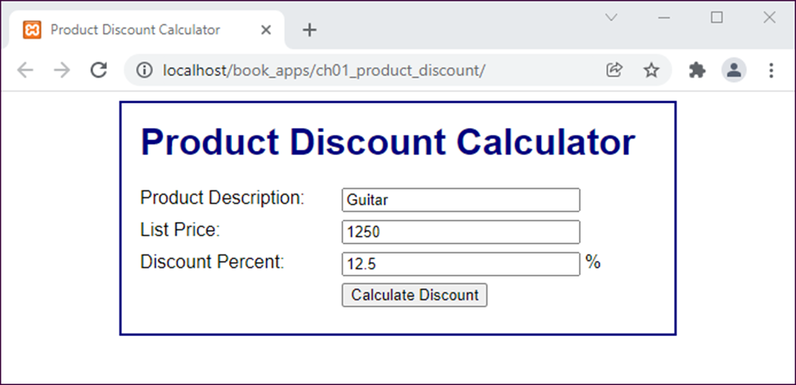
The first page of an application (index.html)

Slide 20
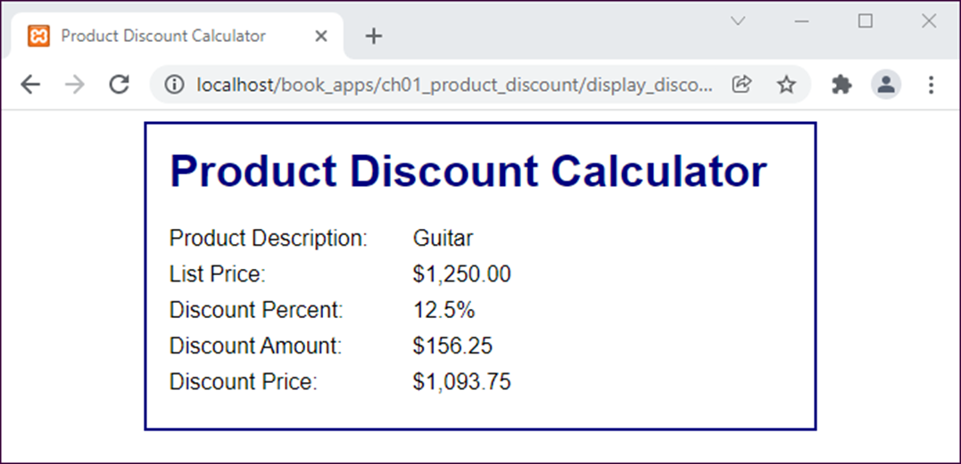
The second page (display_discount.php)

Slide 21
The HTML file (index.html) (part 1)
<!DOCTYPE html>
<html>
<head>
<title>Product Discount Calculator</title>
<link rel="stylesheet" href="main.css">
</head>
<body>
<main>
<h1>Product Discount Calculator</h1>
<form action="display_discount.php" method="post">
<div id="data">
<label>Product Description:</label>
<input type="text" name="product_description"><br>
<label>List Price:</label>
<input type="text" name="list_price"><br>

Slide 22
The HTML file (index.html) (part 2)
<label>Discount Percent:</label>
<input type="text" name="discount_percent">
<span>%</span><br>
</div>
<div id="buttons">
<label>&nbsp;</label>
<input type="submit" value="Calculate Discount"><br>
</div>
</form>
</main>
</body>
</html>

Slide 23
The CSS file (main.css) (part 1)
body {
font-family: Arial, Helvetica, sans-serif;
margin: 1em;
padding: 0;
}
main {
display: block;
width: 450px;
margin: 0 auto;
padding: 1.5em;
background: white;
border: 2px solid navy;
}
h1 {
color: navy;
}
label {
width: 10em;
padding-right: 1em;
float: left;
}

Slide 24
The CSS file (main.css) (part 2)
#data input {
float: left;
width: 15em;
margin-bottom: .5em;
}
#data span {
padding-left: .25em;
}
#buttons input {
float: left;
margin-bottom: .5em;
}
br {
clear: left;
}

Slide 25
The PHP file (display_discount.php) (part 1)
<?php
// get the data from the form
$product_description = $_POST['product_description'];
$list_price = $_POST['list_price'];
$discount_percent = $_POST['discount_percent'];
// calculate the discount
$discount = $list_price * $discount_percent * .01;
$discount_price = $list_price - $discount;
// apply formatting to the dollar and percent amounts
$list_price_formatted = "$".number_format($list_price, 2);
$discount_percent_formatted =
number_format($discount_percent, 1)."%";
$discount_formatted = "$".number_format($discount, 2);
$discount_price_formatted =
"$".number_format($discount_price, 2);
// escape the unformatted input
$product_description_escaped =
htmlspecialchars($product_description);
?>

Slide 26
The PHP file (display_discount.php) (part 2)
<!DOCTYPE html>
<html>
<head>
<title>Product Discount Calculator</title>
<link rel="stylesheet" href="main.css">
</head>
<body>
<main>
<h1>Product Discount Calculator</h1>
<label>Product Description:</label>
<span><?php echo $product_description_escaped; ?>
</span><br>
<label>List Price:</label>
<span><?php echo $list_price_formatted; ?></span><br>

Slide 27
The PHP file (display_discount.php) (part 3)
<label>Discount Percent:</label>
<span><?php echo $discount_percent_formatted; ?></span><br>
<label>Discount Amount:</label>
<span><?php echo $discount_formatted; ?></span><br>
<label>Discount Price:</label>
<span><?php echo $discount_price_formatted; ?></span><br>
</main>
</body>
</html>

Slide 28
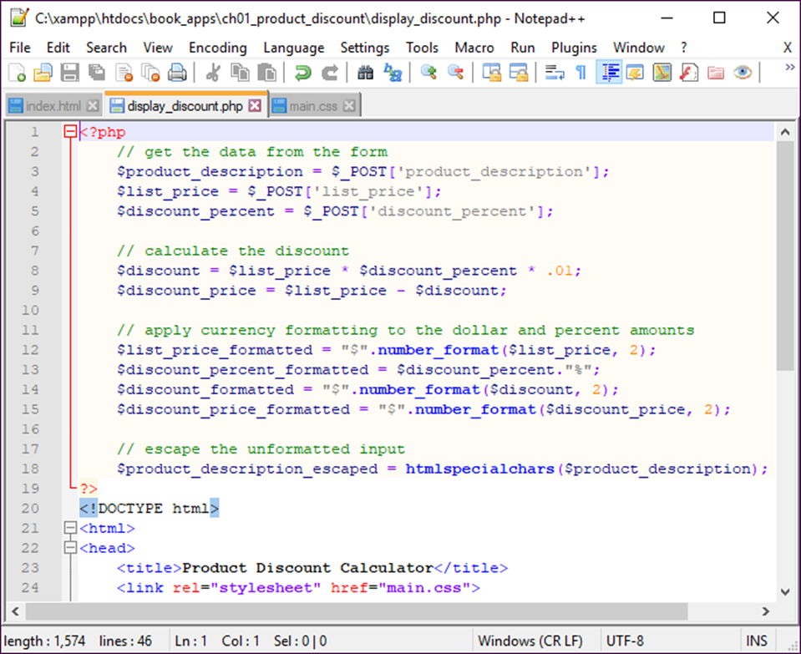
Notepad++ with three tabs open

Slide 29
How to open files in Notepad++
Use the Open button in the Notepad++ toolbar.
Right-click on the file in File Explorer and select the Edit with Notepad++.
How to save the current file
Use the Save button in the toolbar.
Press Ctrl+S.
How to save all open files
Use the Save All button.

Slide 30
How to close the current file in Notepad++
Use the Close button in the toolbar.
How to close all open files
Use the Close All button.
How to open a new file in a new tab
Use the New button in the toolbar.

Slide 31
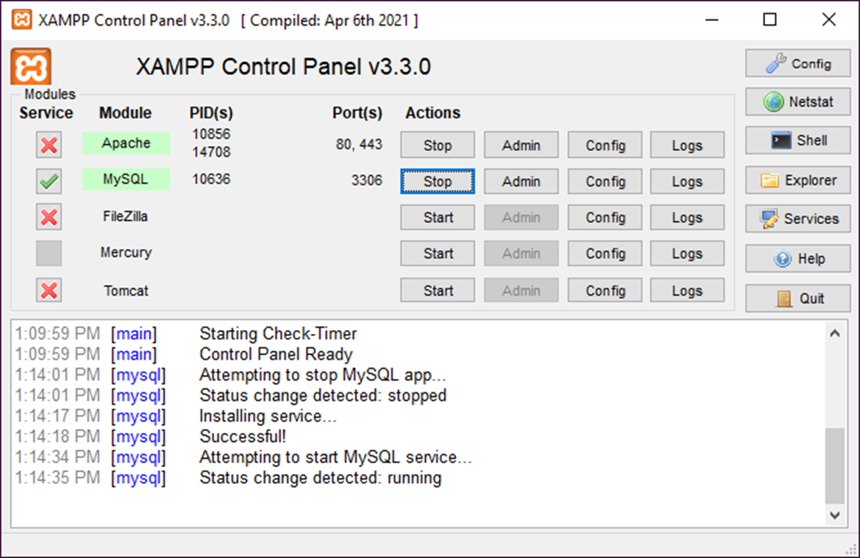
The XAMPP Control Panel

Slide 32
How to start the XAMPP control panel
On a Windows system, select the XAMPP Control Panel item from the Windows Start menu.
On a macOS system, open the Applications folder, open the XAMPP folder, and double-click the manager-osx application.
How to start and stop Apache or MySQL
Click on its Start or Stop button.
To start Apache or MySQL automatically when your computer starts, please refer to the appendixes.

Slide 33
About XAMPP
XAMPP is a free, open-source web server package.
The package includes Apache, MySQL, and an interpreter for PHP.
XAMPP can be easily installed.
XAMPP is available for Windows, macOS, and Linux systems (the X in XAMPP stands for cross-platform).

Slide 34
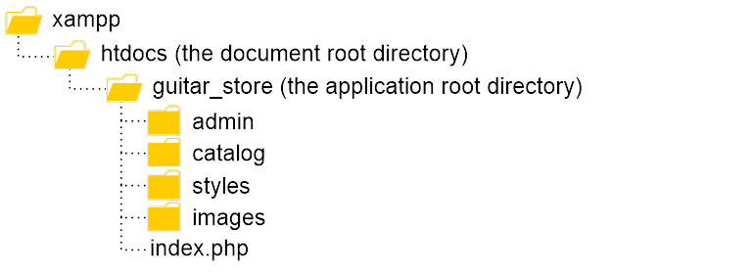
The directories for a PHP app on a local server

Slide 35
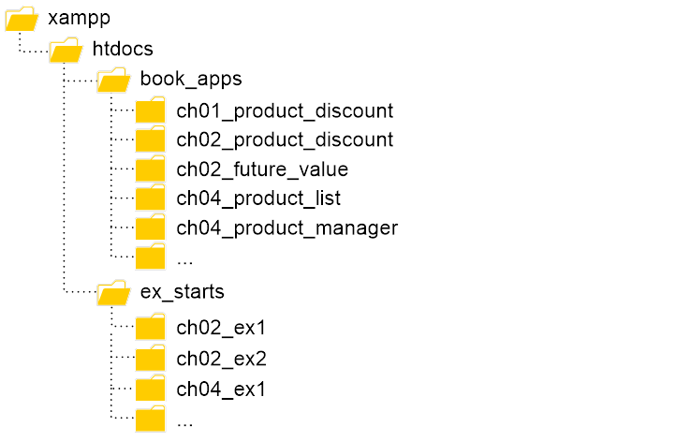
The structure for book_apps and ex_starts

Slide 36
How to deploy a PHP application on a local server
Copy all of the directories and files for an application to the \xampp\htdocs directory on the server.
How to deploy the downloadable applications on a local server
Copy the book_apps and ex_starts directories and all their contents to the \xampp\htdocs directory on the server.
How to deploy an application on an internet server
Use an FTP (File Transfer Protocol) program to upload the tested directories and files to the htdocs directory of the Apache web server.

Slide 37
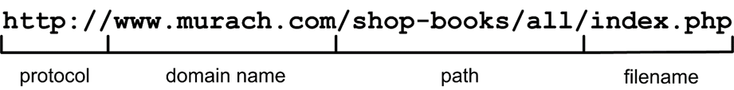
The components of an HTTP URL
What happens if you omit parts of a URL
If you omit the protocol, the default of http:// will be used.
If you omit the filename, one of the default filenames for the Apache web server will be used: index.htm, index.html, or index.php.
If you omit the filename and there is no default file, Apache will display an index of the files and directories in the path.

Slide 38
Requesting pages from an internet web server
A request for a specific page
http://www.murach.com/shop-books/all/index.php
A request for the default (home) page of a website
http://www.murach.com/
Requesting applications from a local web server
A request for the default page in an application directory
http://localhost/book_apps/ch01_product_discount/
A request for a directory with no default page
http://localhost/book_apps/

Slide 39
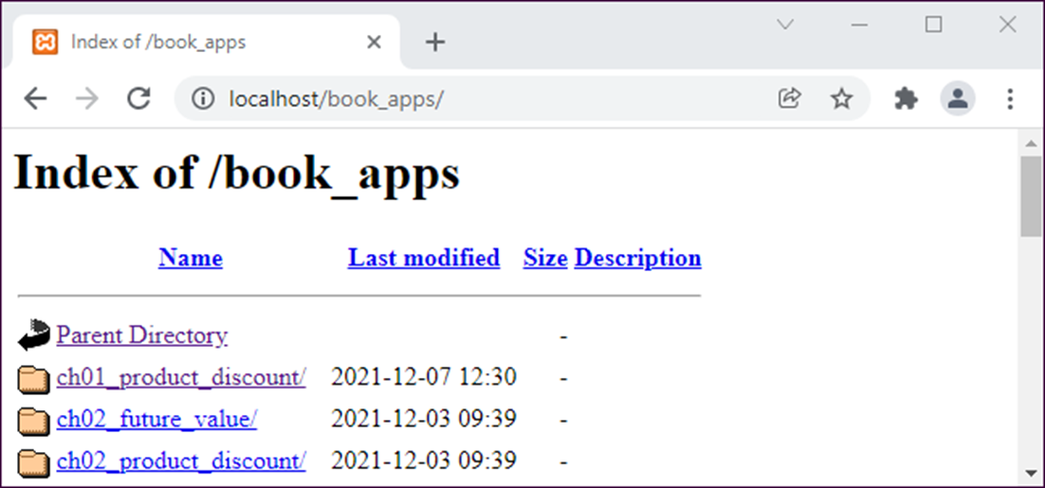
An index of the apps in the book_apps directory

Slide 40
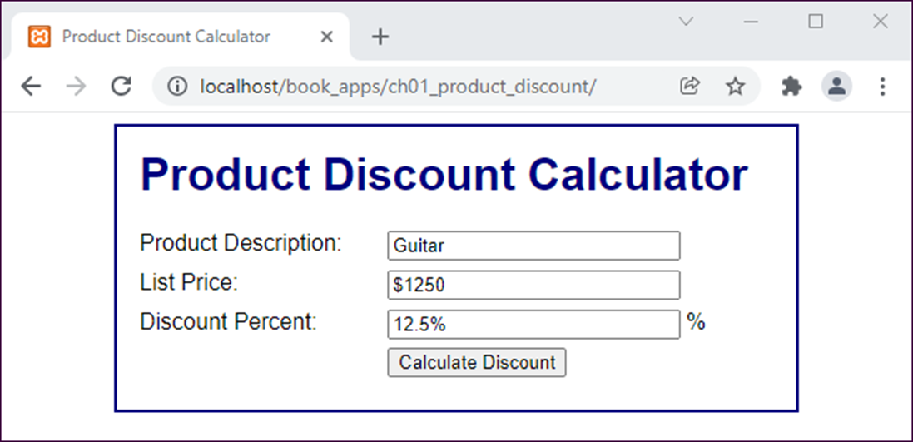
The Product Discount application in Chrome

Slide 41
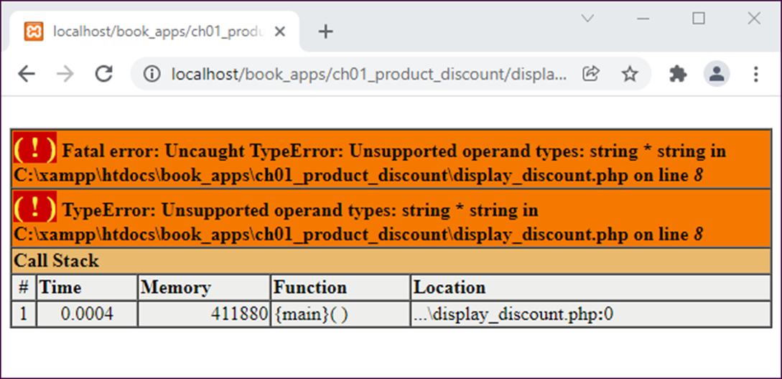
An error displayed in Chrome

Slide 42
How to test a PHP page for the first time
Make sure the Apache and MySQL servers are running.
Start a web browser and enter the URL for the application.
Test the page by entering both valid and invalid data, clicking on all links, and so on.
How to retest a PHP page after you change the source code
Click the Reload or Refresh button in the browser.

Slide 43
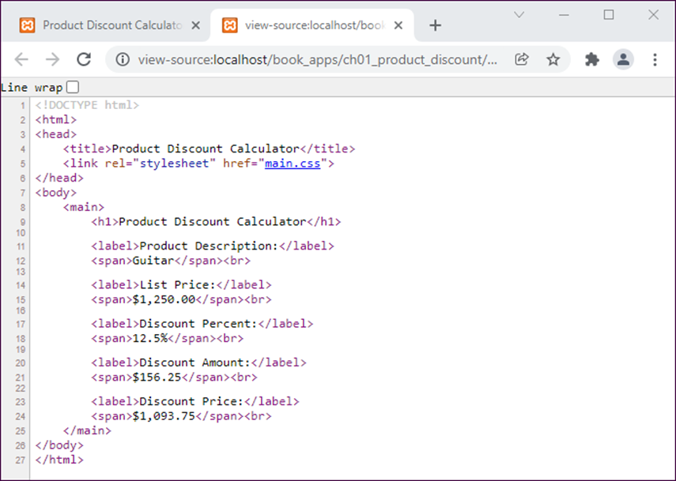
The source code for a PHP page
How to view the source code for a page
Right-click the page and then select the View Page Source command.

Slide 44
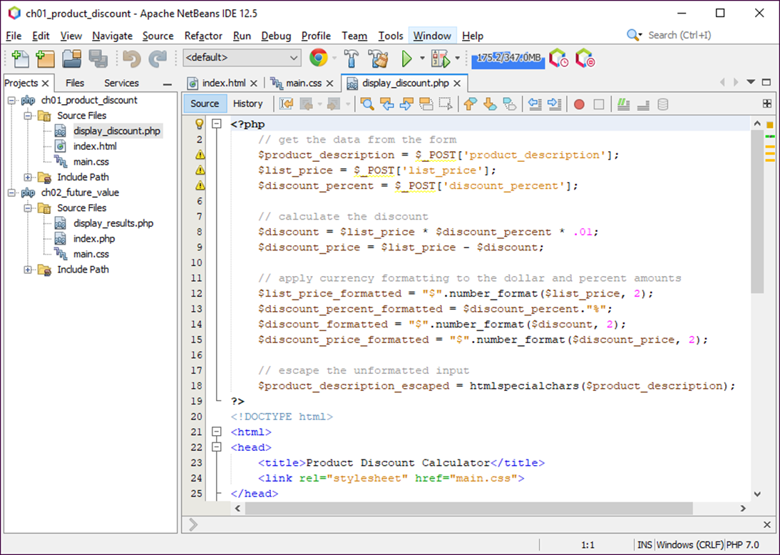
NetBeans with three files in a project open

Slide 45
How to work with NetBeans projects
To open a project, use the Open Project button in the toolbar.
To start a new project, use the New Project button in the toolbar.
To close a project, right-click on the project in the Projects tab and select the Close command from the resulting menu.
How to work with files
To open a file, use the Projects tab to navigate to the file and then double-click the file.
To start a new file, select the project and click the New File button in the toolbar.

Slide 46
About NetBeans
NetBeans is an Integrated Development Environment (IDE) for developing PHP applications.
NetBeans can make it easier to create, edit, and test the HTML, CSS, and PHP files that you need for a web application.
About NetBeans projects
A NetBeans project consists of a top-level directory that contains the subdirectories and files for an application.
NetBeans adds an nbproject subdirectory that contains the extra files that NetBeans needs for managing the project.
A note about right-clicking in macOS
To enable right-clicking with macOS you can edit the system preferences for the mouse.

Slide 47
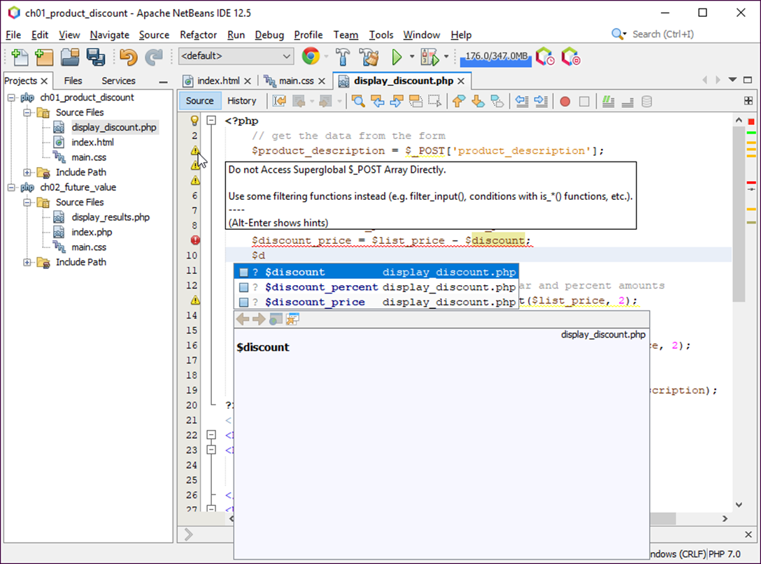
Auto-completion and error marking in NetBeans

Slide 48
How to edit a PHP file with NetBeans
Use normal editing techniques as you enter PHP code.
When you see an auto-completion list, you can highlight an entry and press the Enter key to enter it into your code or you can double-click on it.
If you see a red error icon at the start of a line, you should fix whatever errors the line contains before you test the application.
If you see a yellow warning icon at the start of a line, you can hover the mouse over the icon to read the warning. Then, you can fix the issue if you want.

Slide 49
How to test a PHP application with NetBeans
To run the current project, click on the Run Project button in the toolbar or press F6.
To run other projects, right-click on the project and select the Run command.
To run a file, right-click on the file and select the Run command.

Slide 50
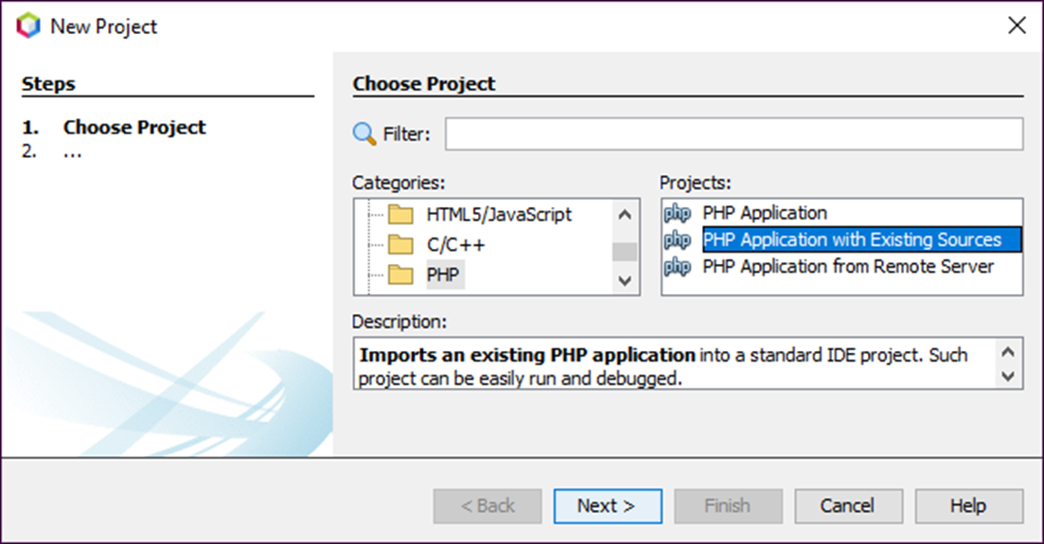
The dialog box for starting a new project

Slide 51
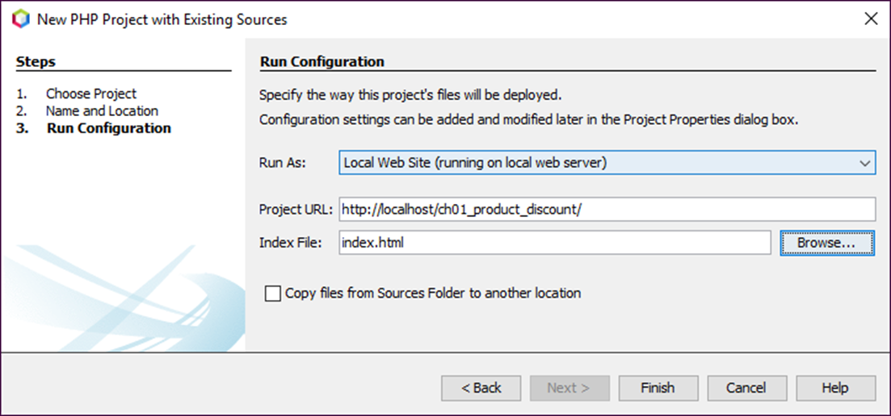
The dialog box for configuring a project

Slide 52
How to check the run configuration for a project
Right-click on a project in the Projects tab and select the Properties command.
Then, click on Run Configuration in the Categories list and check the Project URL.
How to import a project
To import a project, use the New Project command, but select PHP Application with Existing Sources in the Projects list.
This will step you through the import procedure.
In the third step, you will be asked to check the run configuration. Here, you need to make sure the URL for running the project is correct.

